Slide 1


Local Transportion Search Engine
NAME: Tahmid Asif Sadman
ID:18101166
Section: 04
Group: 17

Slide 2
Introduction
There are different systems available for private transportation facilities but it mainly focuses on higher and higher middle-class people. However, in my project my target customers are the people who cannot afford private transportation facilities rather they prefer local transports. There are also cases where people require proper guidance for traveling in the local transport to save a lot of hassle and time. I am trying to make transportation more accessible, reducing congestion by getting more people on fewer available local transports. The main focus of this system is to manage and control public transports (Inter-city). A Transportation Management System is a software system designed to manage transportation operations and ensure better transport service, decrease routing time with optimized cost and efficiency.

Slide 3
Planning:
The purpose of this system is to manage and control public transports (Inter-city). A Transportation Management System is a software system designed to manage transportation operations and ensure better transport service, decrease routing time with optimized cost and efficiency.

Slide 4
Analysis:
1. Features:
One of the key features is users will know about trip details and they can find a list of available and suitable rides. Secondly, they can get an estimated fare for traveling a specific distance. In addition to that, it will help them to travel with optimal fare. Thirdly, it will inform the user regarding the multiple drop off points throughout the journey. Moreover, it will get numbers and analyze the data to rate local transports. Fourthly, the system will have online booking options. In conclusion, it will help the user to find a suitable companion for traveling and to communicate with each other to make their journey comfortable and enjoying. In some case, it also helps to ensure a safe and secured ride specially for women, children and old people.

Slide 5
2. Users
The target market for our web base system is anyone who needs a short to mid-distance local transportation within the cities. Especially the men and women traveling frequently for work or business who needs a budget ride. One of our main focuses is the students who need an affordable and accessible transportation system. Especially, young girls get harassed in local buses most often, this system will provide security for them. So, while traveling to unknown routes It becomes harder for the normal students to afford other private riding facilities (Applications). And many of us are not aware of the student fare of different local transports. This system will notify them about these facilities.

Slide 6
3. Proposed Technology
Web based Platform, server, central database, user friendly web with cost estimation, dynamically updated data to ensure reliability.
4. Constraints
Limited secondary data available. Its time consuming to collect primary data. Less chances of open-ended interview for requirement collection from end users. Very few people are compatible with existing transportation applications so it will require time to make them familiar with our developed system. Frequent changes in local bus route require frequent changes in database which decreases the quality of program code. Limited time span to analyze and implement such a vast and dynamic project. Also, this projects need financial supports to stand on its own.

Slide 7
5. Project Scope
The project will include design, test and Web based system to help people find out available transports in affordable price and optimized roots for faster travelling. All hardware and software resources will be managed by the project group. Mainly we will focus on the Database design, schema design, web base UI platform design. We will focus on equivalence partition base testing, component testing and integrated system testing. The project is funded by the group members.

Slide 8
Design:
1) Transportation cost (Fair) estimation
A. Assume fair based on selected stoppage.
B. Suggest vehicles with minimal fair.
C. Suggest sitting service vehicles.
2) Data storage and sharing
A. Archive of all vehicles and their possible routes.
3) Suitable Vehicle suggestions based on Route Selection
A. Consumer will select his source and destination point, our software will suggest suitable vehicles that
cover those routes.

Slide 9
Requirement Analysis:
1. Functional requirements:
A. Searching & Booking
A.1 The user can search for desired vehicle.
A.2 The user can view a list of available vehicles.
A.3 The user can select optimal and suitable root to reach his destination.
A.4 The user can select different categories of buses.
A.5 The user can book tickets online and confirmation message will be sent to the user by Email or Phone number.
A.6 The user can choose source and destination location.
A.7 The user can view all the routes.
B. Cost estimation
B.1 The user can check the estimated fare for travelling a certain distance.
B.2 The users can compare between the fares.
B3. The system will suggest buses to travel at minimum cost.
B4. The user can perform payment in multiple mode such as cash, Bikash, rocket etc.
C. Printing
C.1 The user can print his/her online ticket.
C.2 The user can view a preview of the available roots before selecting.

Slide 10
2. Nonfunctional requirements
A. Operational requirements:
A.1 The system should be able to work in any web browser.
A.2 The system will operate in Windows environment.
B. Performance requirements
B.1 Response time should be less than 30 seconds.
B.2 The database will be updated every day.
B.3 The system should be available for use 24 hours.
C. Security requirements
C.1 Only admin can permit to change or add routes.
C.2 The system will guaranty customer’s information on source and destination confidential.
D. Cultural and political requirements
D.1 During strikes and political gatherings and rally some of the transports may not be available for general users.
D.2 Only the buses and routes verified by BRTA should be enlisted to our inventory.

Slide 11
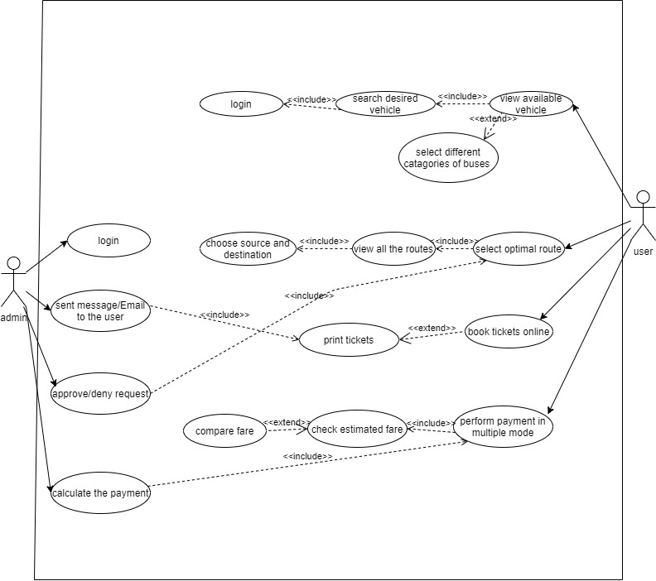
Use Case Diagrams:

Slide 12
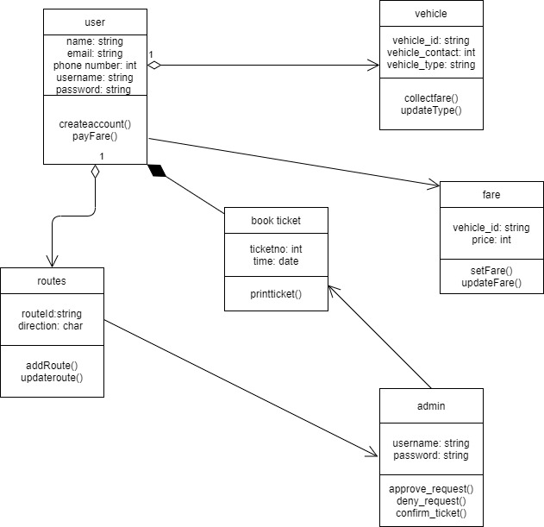
Class Diagram:

Slide 13
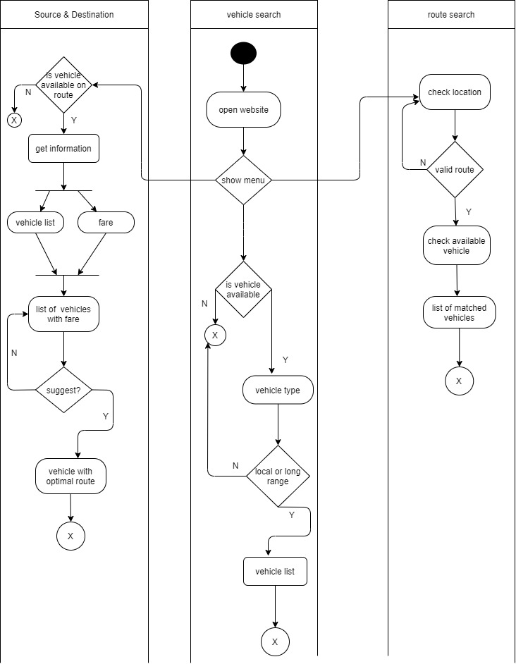
Activity Diagram:

Slide 14
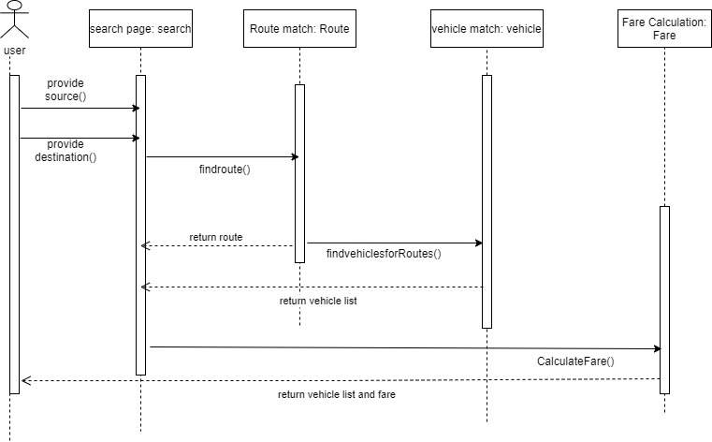
Sequence Diagram:

Slide 15
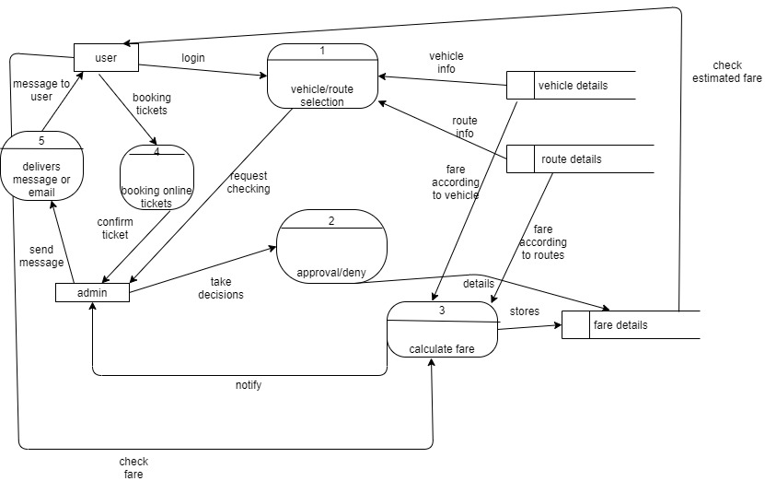
Data Flow Diagram: (Level 0)

Slide 16
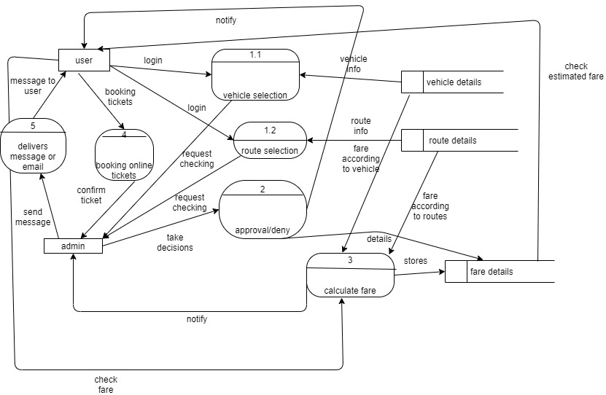
Data Flow Diagram (Level 1):

Slide 17
Summary & Conclusion:
Last but not the least, this project’s whole intention is to make those people’s lives easier who cannot afford private transportation facilities. Moreover, this project also focuses on those people who require guidance while transporting in the local transport to save a lot of hassle especially young girls who suffers the most in local transportation services every day. This project will make the transportation cozier and more accessible for many people. This project will ensure better transport operations and ensure better transport service, decrease routing time with optimized cost and efficiency.

